Slide 1



Harms of workplace inspections for im/migrant sex workers in indoor establishments:
Enhanced barriers to health access
in a Canadian setting
Bronwyn McBride^{1, 2}, Kate Shannon^{1, 3}, Putu Duff ¹, Minshu Mo ¹,
Melissa Braschel ¹, Shira M. Goldenberg ^{1, 4}, on behalf of the AESHA Project
¹ Gender and Sexual Health Initiative, BC Centre for Excellence in HIV/AIDS, Vancouver, Canada
² Interdisciplinary Studies Graduate Program, University of British Columbia, Vancouver, Canada
³ Faculty of Medicine, University of British Columbia, Vancouver, Canada
⁴ Faculty of Health Sciences, Simon Fraser University, Burnaby, Canada

Slide 2
Conflict of Interest
I have no conflict of interest to declare.

Slide 3
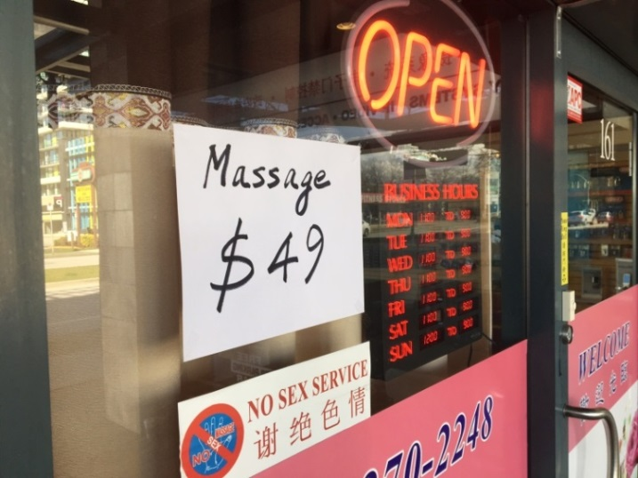
Labour, health and rights amongst im/migrant sex workers
Im/migrant sex workers face barriers to health access and health inequities
In Canada, recent im/migrant sex workers face a 3-fold increased odds of unmet health needs
Im/migrant sex workers more likely to work indoors: these sites are targets for raids & inspections
Image: Richmond News

Slide 4
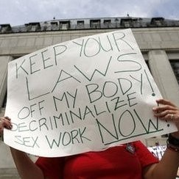
2014 Canadian end-demand legislation
(Protection of Communities and Exploited Persons Act)
Key features
Group | Activity | Legal status
Canadian citizens | Selling sex services | legal
Temporary residents; im/migrants on open work permits | Selling sex services; doing ANY form of work in an indoor sex work venue | criminalized
Clients | Purchasing sex services | criminalized
Third parties | Gaining material benefits in a sex work venue | criminalized
Image: Osgoode Hall Law School

Slide 5
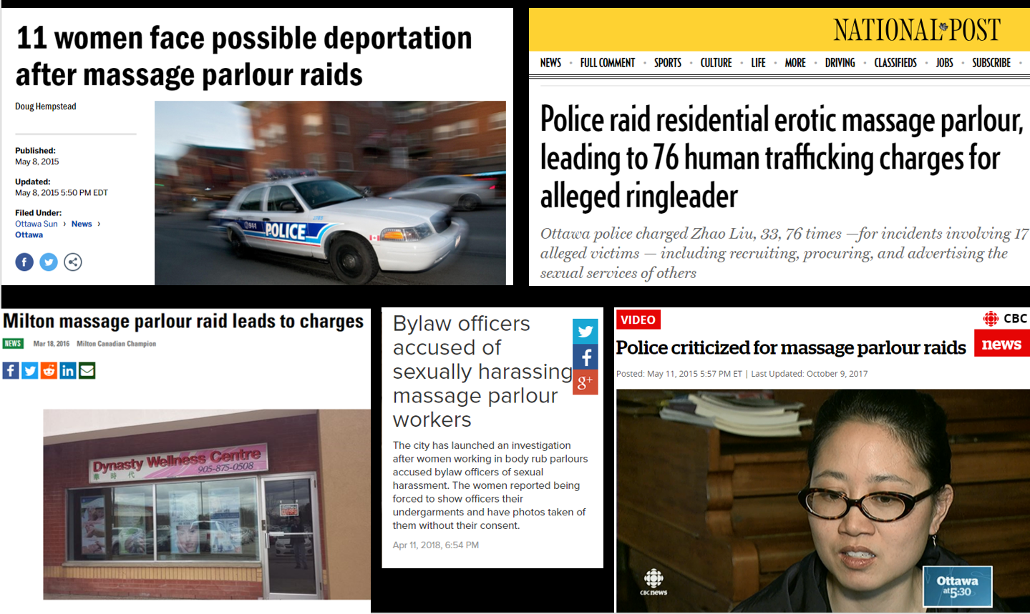
Massage parlour raids/inspections

Slide 6
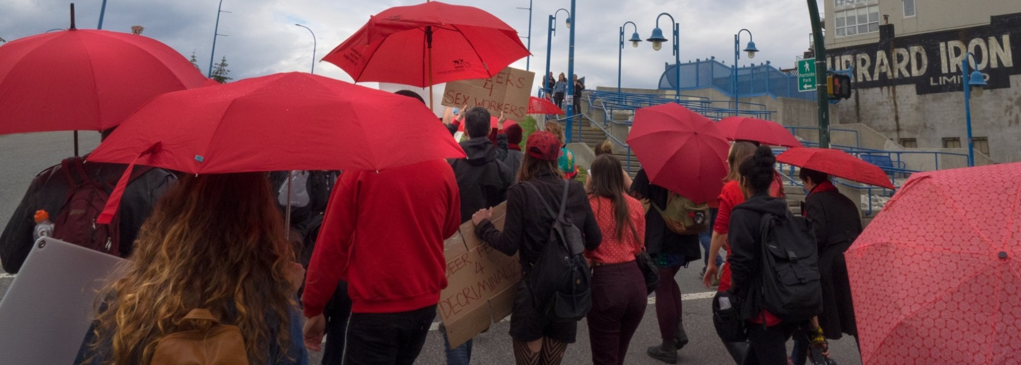
Objectives
1: Examine factors associated with worrying about workplace inspections (by police, immigration, municipal or health inspectors) among indoor sex workers.
2: Examine the effect of worry about inspections on workers’ health access.
Image: Sex Workers United Against Violence, Sally T. Buck

Slide 7





Methods: An Evaluation of
Sex Workers Health Access
Community-based prospective study involving 900+ sex workers in Vancouver
Current/former sex workers and multilingual staff are represented across study teams
Eligibility: Women (cis and trans); 14+; did sex work in last month
Participants invited through outreach; complete semi-annual interviewer-administered questionnaires and voluntary HIV/STI/HCV testing
AESHA outreach team delivering sexual health supplies
Notes:
7

Slide 8

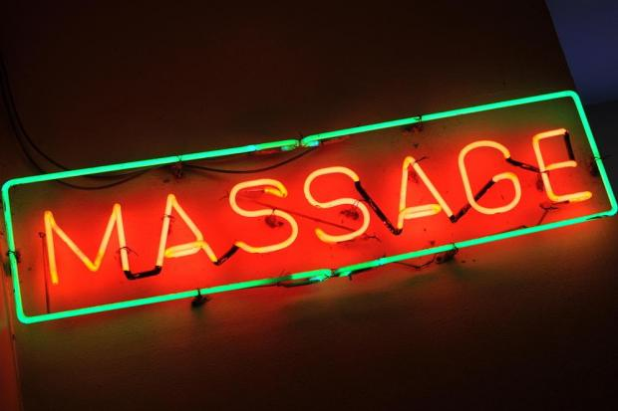
Worry about inspections (2014-2017)
Time-updated outcome: Worry about economic/ social/legal consequences of workplace inspections, last 6 months
Main independent variable: Migration history
Additional variables:
Analyses: Multivariable logistic regression with generalized estimating equations (GEE)
-age, education | -workplace violence, work stress
-substance use | -police harassment
-barriers to health care | -condom sources/practices

Slide 9
Results (925 observations, 397 participants)
23.9% experienced an inspection: no differences in rates of inspections pre/post law reform
51.6% worried about inspections
28% of the sample were im/migrants
Among recent im/migrants, 45% worried about losing their status or being deported
What participants worried about:
66% | Police scaring clients
44% | Police harassing clients
42% | Arrest for sex work
39% | Family finding out about sex work
10% | Arrest for having condoms

Slide 10
Multivariable GEE Analysis
Factors associated with worry about workplace inspections among indoor sex workers in Vancouver (n=397), AESHA 2014-2017
Variable | Adjusted Odds Ratio (95% CI)
Age (per year older) | 0.97 (0.95 – 0.99)‡‡
Recent im/migrant (<5 years) | 3.13 (1.77 – 5.53)‡‡
Long term im/migrant (>5 years) | 1.78 (1.08 – 2.95)‡‡
Total work stress score* (per +1 score on continuous scale) | 1.05 (1.01 – 1.09)‡‡
Faced police harassment without arrest* | 3.49 (1.92 – 6.34)‡‡
Faced physical/sexual/verbal workplace violence* | 1.66 (1.09 – 2.51)‡‡
* Time-updated measures ‡‡ Significant at p <= 0.05 Variables considered but not retained in the model included English fluency, citizenship status, working in a formal indoor venue, and accessing most condoms from mobile outreach

Slide 11
GEE confounder model
Independent effect of worry about inspections on barriers to healthcare in the last six months among indoor sex workers in Vancouver (n=397), AESHA 2014-2017
Exposure | Barriers to healthcare Adjusted Odds Ratio (95% CI)
Worry about inspections | 1.45 (1.06-1.98)
Confounder model adjusted for recent and long-term im/migration, recent workplace violence, and recent police harassment.

Slide 12
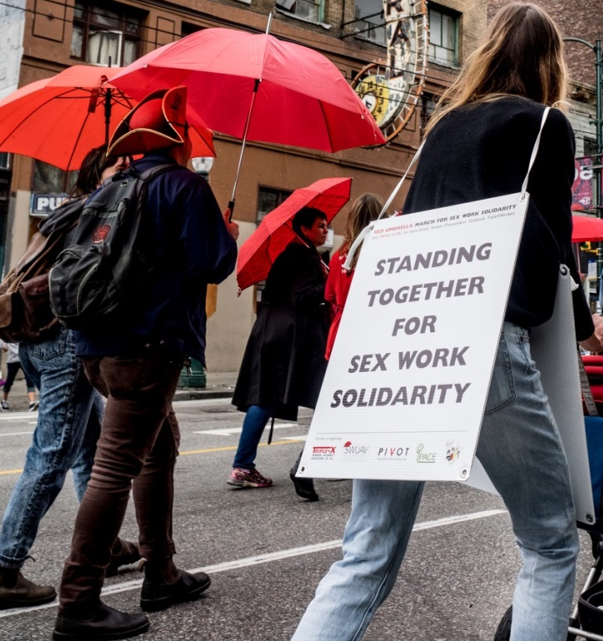
Key findings and implications
51.6% of indoor sex workers worried about inspections; recent im/migrants disproportionately impacted
Worry about inspections independently associated with barriers to health care: unintended health consequences of policing approaches
10% feared arrest for having condoms: HIV prevention implications
Targeted inspections of indoor venues may undermine their protective effects
Image: Sex Workers United Against Violence; Sally T. Buck

Slide 13
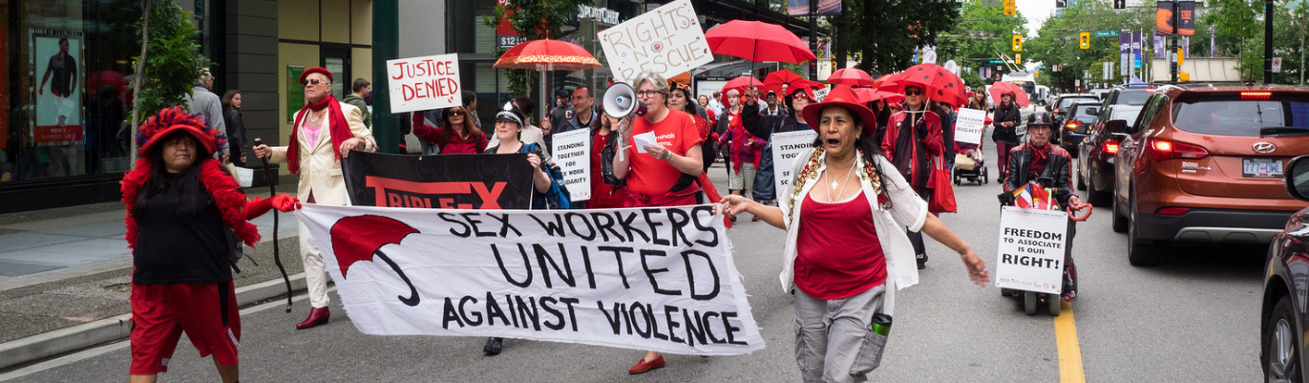
Policy recommendations
Image: Sex Workers United Against Violence; Sally T. Buck
This evidence contrasts with the health & safety aims of end-demand legislation.
Policy bodies should shift towards:
  Ending targeted policing of safer indoor sex work venues
  Labour frameworks which support all sex workers’ health and rights
  Distinguishing sex work from trafficking

Slide 14
Acknowledgements
Community Advisory Board
WISH, SWUAV, SWAN, PACE, HUSTLE/HiM, Options for Sexual Health,
Vancouver Coastal Health, BCCDC Street Nurses, ATIRA, RainCity, Pivot Legal Society,
Positive Women’s Network, YouthCO, Canadian HIV/AIDS Legal Network
Research & administrative support
Sarah Moreheart, Jennifer Morris, Brittney Udall, Sylvia Machat, Jane Li,
Minshu Mo, Jennifer McDermid, Alka Murphy, Tave Cole, Jaime Adams,
Lydia Hamel, Abby Rolston, Anita Dhanoa, Ray Croy, Emily Leake,
Natalie Blair, Peter Vann, Colette Ryan, Erin Seatter
Funding
US National Institutes of Health,
Canadian Institutes of Health Research
MacAIDS
Notes:
14

Slide 15
Trafficking
‘Anti-trafficking efforts such as police raids and rescue operations in indoor sex work venues can exacerbate health inequities and human rights violations among sex workers by displacing them to isolated and unsafe work environments; undermining their access to health care; and increasing their vulnerability to police abuses.’ (Goldenberg 2015, Lancet Global Health)
Contrary to stereotypes, 1.8% (n= 3/163) of im/migrant women in the AESHA cohort reported being coerced into sex work (Goldenberg et al. 2014, JOIMH)
Despite anti-trafficking initiatives, from 2005 to 2015, there were 34 convictions for human trafficking in Canada (Royal Canadian Mounted Police, 2015)
Advocacy groups report that im/migrant sex workers continue to be arrested, detained and deported (Butterfly Asian and Migrant Sex Workers Network 2018)
Notes:
15

